Slide 1
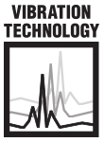
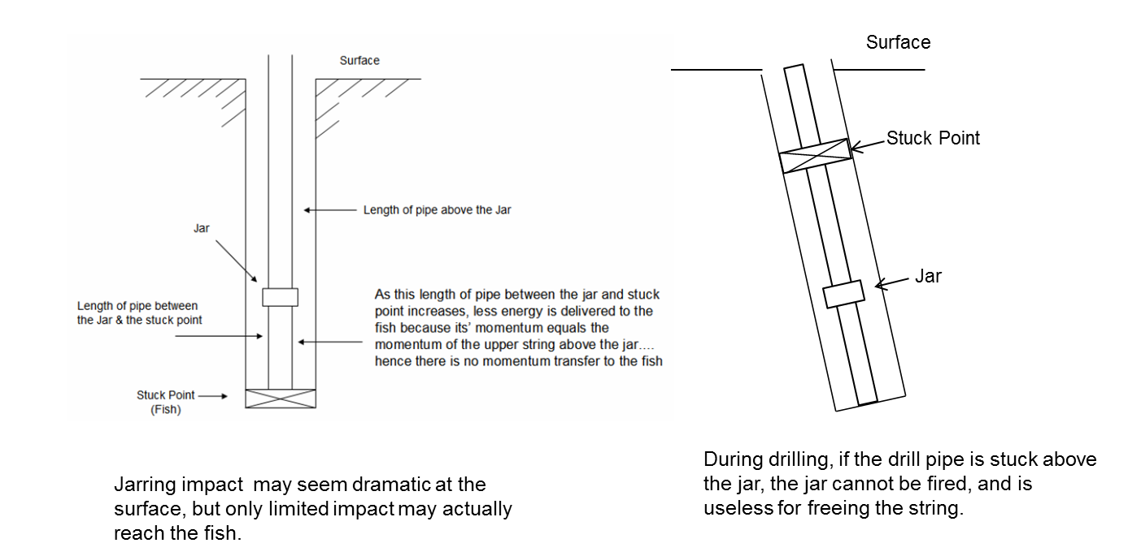
VIBRATION TECHNOLOGY
Limitations of Jarring

Slide 2
VIBRATION TECHNOLOGY
Limitations of Jarring
A jar’s large instantaneous
impact energy dissipates quickly as the impulse decays while traveling down the drill pipe.

Slide 3
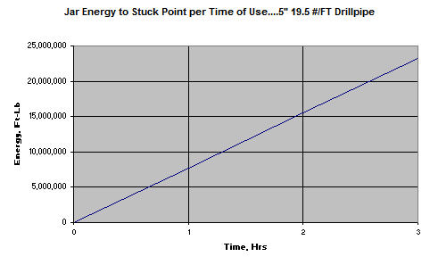
VIBRATION TECHNOLOGY
Limitations of Jarring
90 jar trips in 3 hours deliver only 23.2 million ft-lb to stuck point.

Slide 4
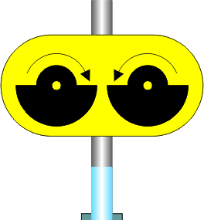
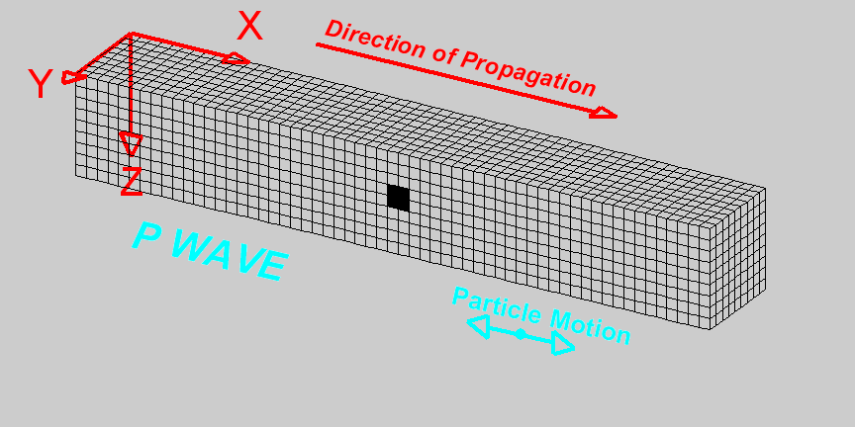
VIBRATION TECHNOLOGY
Surface →
Energy Delivered by Vibration Technology
This is the wave shape that gets transmitted downhole to the Stuck Point.
Deformation propagates. Particle motion consists of alternating compression and dilation. Particle motion is parallel to the direction of propagation (longitudinal). Material returns to its original shape after wave passes.
← Longitudinal Standing Wave
Well Bore →
Stuck Point →

Slide 5
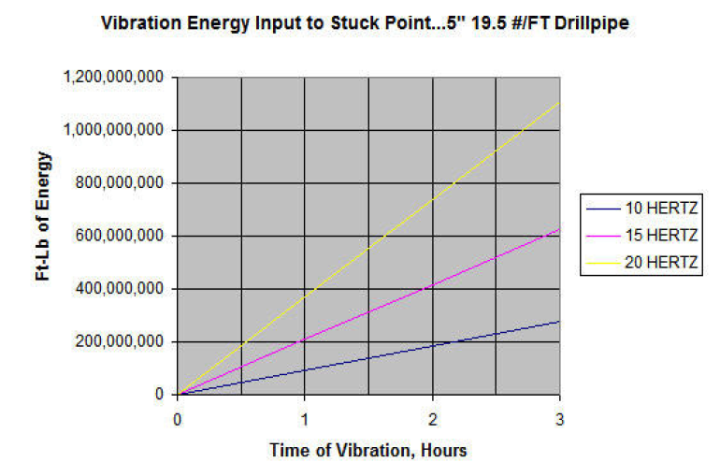
VIBRATION TECHNOLOGY
Energy Delivered by Vibration Technology
Resonant vibration delivers energy continuously to the stuck point.
Operating at 20 Hz for 3 hours, Vibration Technology delivers
1.1 billion ft-lbs of energy to free the pipe.

Slide 6
VIBRATION TECHNOLOGY
Drilling Applications for Vibration Technology
Mechanical sticking
  Inadequate hole cleaning,
  Unconsolidated formations
  Fractured formation
  Faulted formations
  Junk or cement debris
Extended-length sticking
  Chemically active formations,
  Under-gauge holes,
  Mobile formations
  Green cement
Unknown Stuck-Point
  Sticking above the jar
  Over-Pressured Formations
  High-Dip Sloughing
Well Geometry
  Key seating
  Cuttings build-up

Slide 7
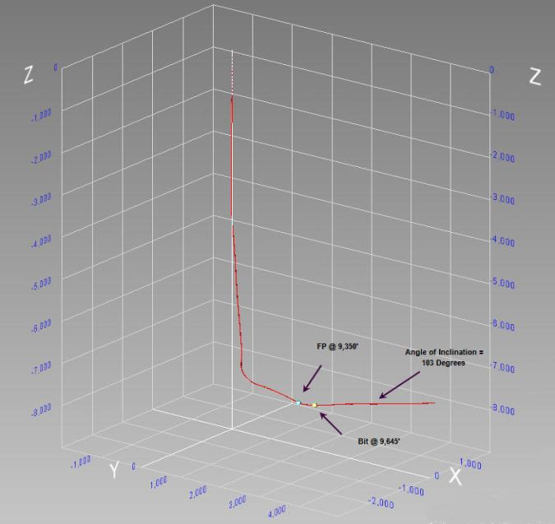
VIBRATION TECHNOLOGY
Case History: Drilling Out Frac Plugs
  Carter County, OK
  MD 9,645'/TVD 8,125‘
  KOP 7,530’
  Work String: 2-7/8" – 10 lb/ft LTC
  Fish: 4-5/8" bit on 2-7/8" tubing
After drilling one plug, lost circulation,
and pipe was stuck.
Pipe was stuck in 103⁰ lateral section
at 9,645' MD. Free Point = 9,350'.
Worked pipe to 75,000# with no results.
After 30 minutes of pipe vibration
the work string began moving upward
Vibration continued and 268 ft of pipe was recovered in the next 8 hours.
Bit reached a severe dog leg
No further progress was made.
Free Point run showed one joint of tubing remained stuck.
Fish was recovered by washover tool.

Slide 8
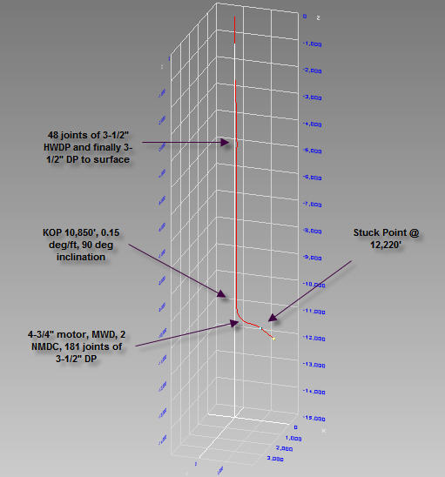
VIBRATION TECHNOLOGY
Case History: Expensive Drilling Assembly
MD 13,449'/TVD 11,348'
KOP 10,850’
Work String: 3-1/2“ DP & HWDP
Fish: 3-1/2“ DP & HWDP, NMDC, 4-3/4” motor
Pipe stuck at 12,200’
Rig jarred on pipe for 3 days.
Stuck for 9 days before calling
Vibration Technology.
Small kick during underbalanced drilling contributed to the sticking.
Rig had spotted oil in the horizontal section and brine in the vertical.
Vibration at 13 Hz with 1” stroke showed work string upward movement in 42 minutes
First joint of pipe was recovered after 74 minutes of resonant vibration.
Vibration continued for 12 minutes, recovering two more joints and 20 ft of subs.
Rig pulled remainder of pipe.
Total vibration time was 86 minutes.
Key: establishing required pull at surface to place a neutral load condition at stuck point

Slide 9
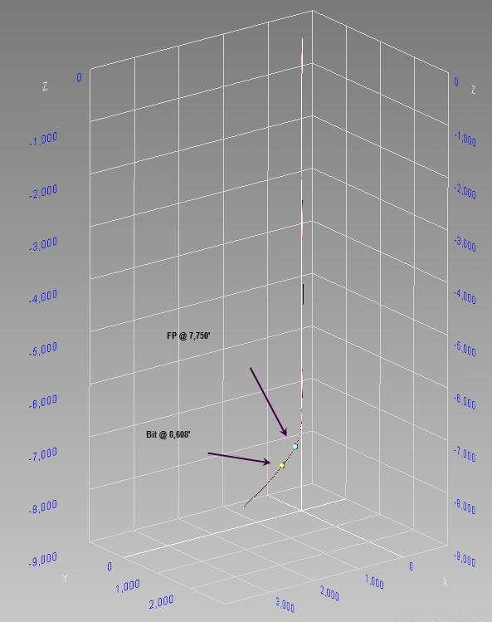
VIBRATION TECHNOLOGY
Case History: Drilling Out Frac Plugs
Montague County, TX
MD 10,951'/TVD 7,746'
Work String: 2⅜" - 4.7 lb/ft EUE N-80
Casing: 5-½" - 17 lb/ft LTC
Fish: 4-¼" bit @ 8,608' on 2⅜" EUE tubing
FP @ 7,750'
Tubing work string stuck while drilling out frac plugs.
Fish was packed off with frac sand.
Jar assembly moved the stuck pipe 16 ft before parting the work string at 7,600 ft.
Ran overshot, backed off, screwed back in, continued jarring with no further movement.
As vibration operation started, work string parted at 6,788 ft
Picked up new 2⅞" - 6.5 lb/ft PH-6 work string.
Vibration continued and the fish began to move slowly up
First joint was laid down after 50 minutes of resonant vibration.

Slide 10
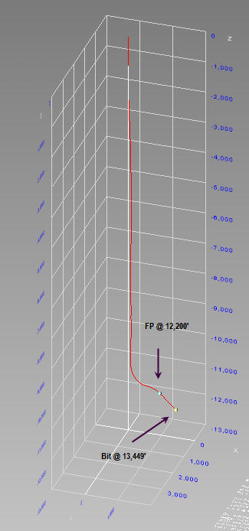
VIBRATION TECHNOLOGY
Case History: Stuck Drilling Assembly
Ward County, TX
MD 13,449'/TVD 11,348'
Work String: 3½" - 13.3 lb/ft DP
Casing: 7" - 29 lb/ft set at 10,728'
BHA: 4½” Bit, Directional Ass'y, DC, DP
Pipe stuck on reaching TD at 13,449 ft MD. Wire Line FP @ 12,2,00' MD.
Full circulation continued but pipe was immovable.
For next 9 days, operator reduced mud weight, spotted fluids, and ran several sets of jars.
Vibration Technology moved the work string after 42 minutes and laid down three joints in next 90 minutes.
At that point the pipe was pulling free with the rig

Slide 11
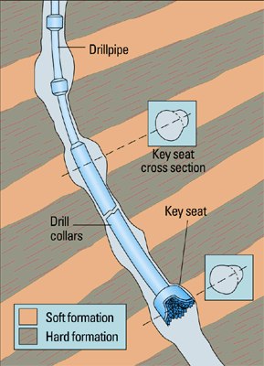
VIBRATION TECHNOLOGY
Case History: Key Seat Stuck Drill Pipe
String Weight: 177,000#... Indicated: 210,000#
Jarred for 2½ days ... Moved pipe 1 ft
BHA stuck at 9,504 ft
Vibrated while varying string tension between 180K - 235K lb. Moved stuck point 330 ft in 1 hour
Tension at 260,000+ lbs while vibrating did not cause further progress
Lowered tension to apply 27,000 lb at stuck point, resumed vibration
Drill pipe moved down 6 ft at surface
1 ½ hours of resonant vibration with 150K- 325K lb tensile pulls brought the 1st joint of drill pipe above the rotary
Rig then pulled 16 joints of drill pipe with intermittent vibration to overcome severe sticking/friction every 30’

Slide 12
VIBRATION TECHNOLOGY
Case History: Formation Stuck Liner
Hook Load: 194,000 lb
Well Depth: 8,878 ft
Stuck at 8,878 ft through a
2⁰ dogleg at casing shoe,
5½⁰at stuck point and 1⁰at TD
Rig spotted 10 bbl of diesel and worked the drill pipe from 250K to 400K lb for 48 hours
Vibrated at Resonance for 26 minutes with string tension of 250K -400K lb .... Gained 2” in. stretch
Increased pull to 420,000+ lbs while vibrating for 1 minute
Drill pipe moved up and down
with 15,000 lb drag
Set the liner to depth

Slide 13
VIBRATION TECHNOLOGY
Case History: Differentially Stuck Liner
9-7/8” 62.8 #/ft casing with
128 centralizers
String weight: 405,000 lb,
12.5 ppg water based mud
Well Depth: 7,138 ft
DifferentiallyStuck @ 3,264 ft
Stuck 51 hours, spotted Black MagicTM
Wellbore geometry: S-shaped well
Vibrated for 54 minutes
with 250K -400K lb string tension
Gained 2-in stretch or 450 ft downward movement at the stuck point
Increased pull to 420,000+ lb while vibrating
Drill pipe moved up and down with 15,000 lb drag
Set the liner to depth

Slide 14
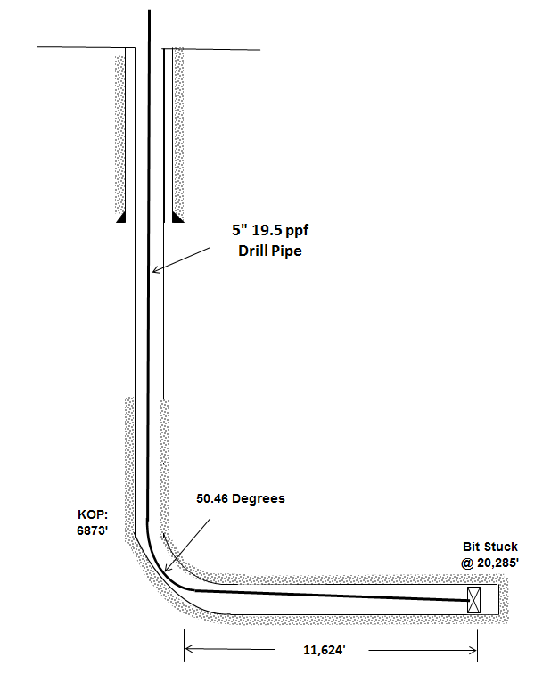
VIBRATION TECHNOLOGY
Case History: Deepest Extraction Laredo Petroleum 2-4-17
BIT STUCK
20,285’
2 MILES
LATERAL LENGTH

Slide 15
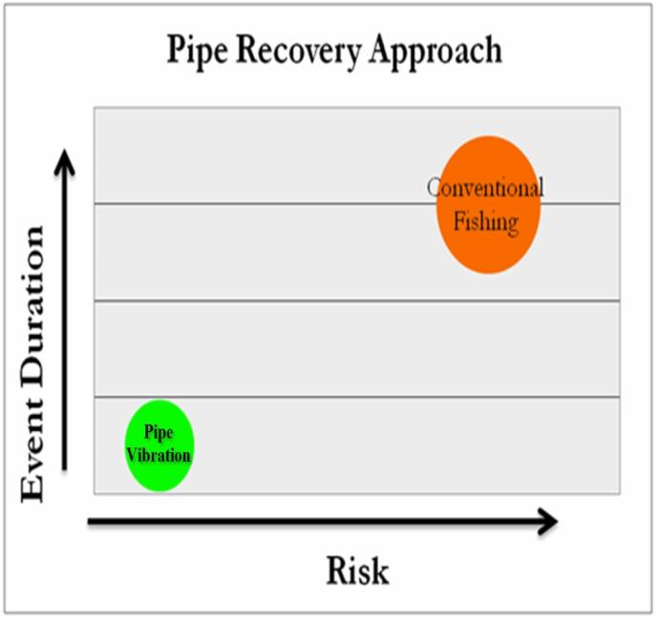
VIBRATION TECHNOLOGY
Vibration Technology Reduces Risk
No downhole intervention required
Procedural risks significantly reduced
Job completed in less time

